Slide 1
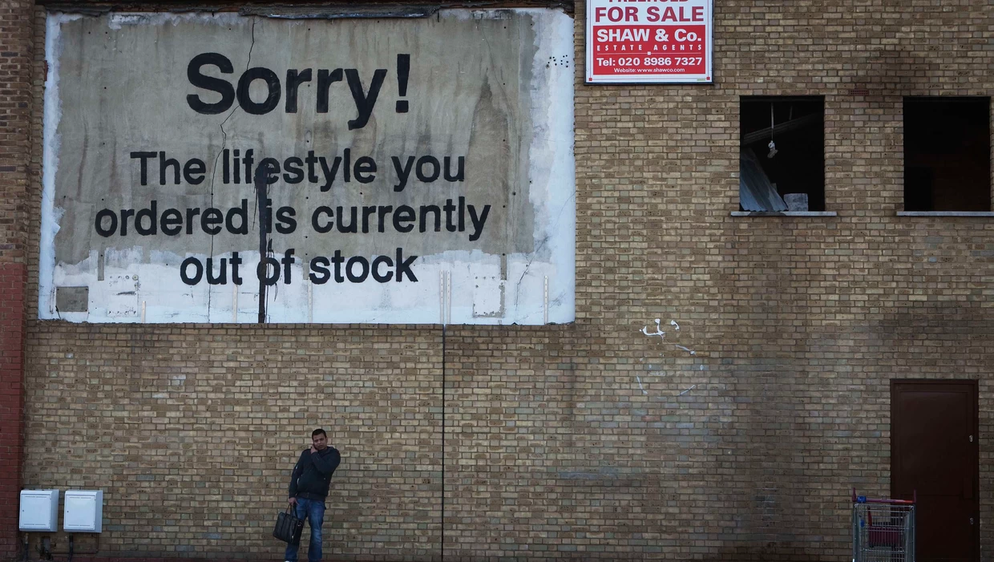
Timeline
Oral exams
Grammar: Past Simple and Present Perfect
Tips for listening test
Work on your own

Slide 2
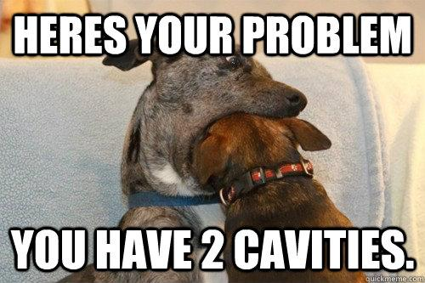
Preparation Oral Exam
Main information
Time
Level 2: 4 – 6 minutes
Level 3: 5 – 7 minutes
Level 4: 6 – 8 minutes
Topic: Your choice
Materials
Powerpoint
Pictures
Other things
When
Choose a date
Delayed = resit
What to do
Make mind map
Make powerpoint
Create wordlist
Ask each other for help

Slide 3
Oral exams DV21A
Planning oral exams
Week Date Name
3 - -
4 15-12 Arjan, Huub, Yessie
5 21-12 Amir, Luuk
6 12-01 TEST VOCAB + GRAMMAR UNIT 2
7 19-01 Indy, Sem, Paola
8 25-01 Britt, Rens, Zenja
9 1-02 Meyke, Myrthe, Anouk
10 9-02 TEST VOCAB + GRAMMAR UNIT 3 + LISTENING

Slide 4
Oral exams HO21
Planning oral exams
Week Date Name
3 - -
4 - -
5 - -
6 12-01 Bart
7 19-01 Lars, Ronnie
8 26-1 Rens, Jop
9 2-02 No class studiedag
10 9-02 Sam, Ryan + TEST VOCAB + GRAMMAR UNIT 2

Slide 5
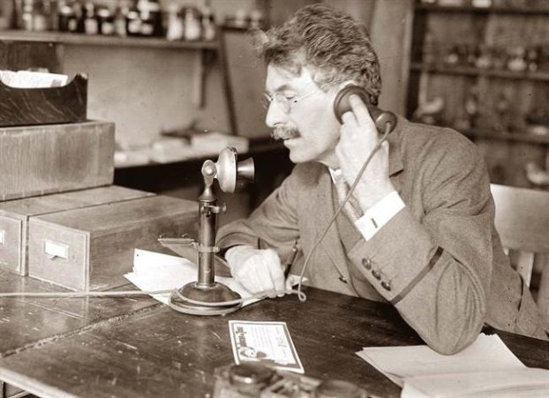
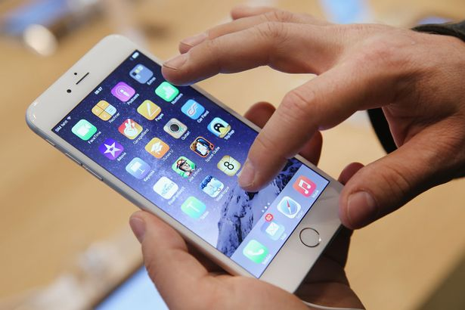
Past Tense
Past Present Future

Slide 6
Past Tense
Past Simple
Present Perfect
Past

Slide 7
Past Tense
Past Simple
Duidelijk wanneer
Present Perfect
Onduidelijk wanneer
Past

Slide 8
Past Tense
Past Simple
Duidelijk wanneer
Gisteren fietste ik naar school
Present Perfect
Onduidelijk wanneer
Ik heb een eind gefietst
Past

Slide 9
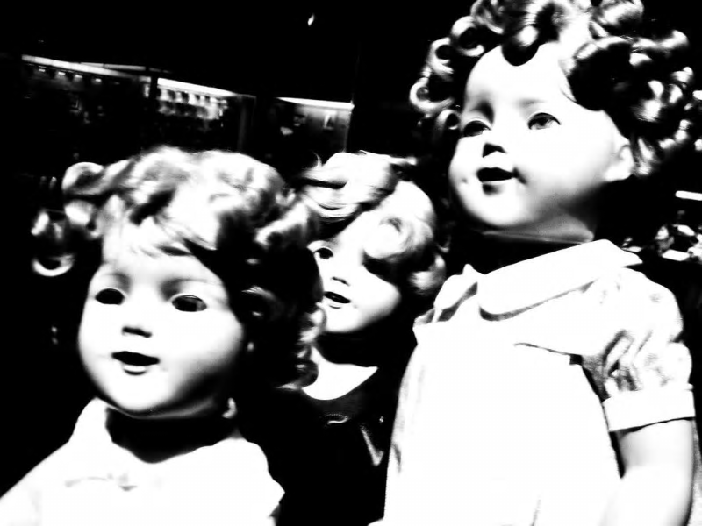
Past Simple
Assignment A
Listen to the story and underline the verbs in the past tense on your worksheet.
Make this assignment on your
own.
We will check the assignment
together.
Notes:
Verhaal komt van: https://www.buzzfeed.com/awesomer/boo-scared-you

Slide 10
Past Simple – Regular verbs
When
Duidelijk wanneer
Indicator
Yesterday
In 1983
Last week
Three days ago
A minute ago
When I was young
Rule
WW + ed
How
I worked
You worked
She/ He/ It worked
We worked
They worked

Slide 11
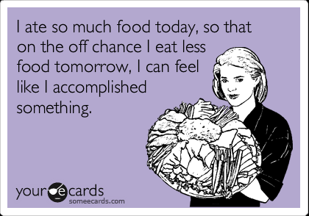
Past Simple – Irregular verbs
Irregular verbs
We also have them in the Dutch language
Regular rule doesn’t apply
Have to learn by heart
There are about 150 – only have to learn 30 (hand out)

Slide 12
Past Simple – Regular and Irregular verbs
Assignment B:
Look at the list of irregular verbs
Read the story again and circle the irregular verbs in the past tense.
Assignment C + D:
Make the assignments on your own
We will check in 5 minutes
Assignment E
Make the assignments on your own
We will check in 5 minutes
Notes:
De foto is de link naar de clip. Deze tekst staat in het begin van het nummer.

Slide 13
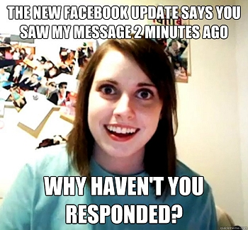
Present Perfect – Example
Past Simple
Present Perfect

Slide 14
Present Perfect – Example
Past Simple
Present Perfect

Slide 15
Present Perfect – Example
Past Simple
Present Perfect

Slide 16
 | Past Simple Ik werkte | Present Perfect Ik heb gewerkt
When | Duidelijk wanneer het gebeurd is | Onduidelijk wanneer het gebeurd is
Rule | ww + ed | Have/ has + ww + ed
Uitzonderingen op de regel | Irregular verbs (onregelmatige werkwoorden) zijn allemaal verschillend en moet je uit je hoofd leren. Krijg je op stencil.
How I | worked | have worked
You | worked | have worked
She / He / It | worked | has worked
We | worked | have worked
They | worked | have worked
Indicator | - Yesterday | For | Already
 | - In 1983 | Yet | Since
 | - Last week | Never | Once
 | - Three days ago | Ever | Recently
 | - A minute ago | Just
 | - When I was young

Slide 17
Past Simple – Regular and Irregular verbs
Assignment F + G + H:
Make the assignments on your own
We will check in 5 minutes
Assignment I
Only level 3 + 4 students
Make the assignments on your own
We will check in 10 minutes
Notes:
De foto is de link naar de clip. Deze tekst staat in het begin van het nummer.

Slide 18
Work on your own

